Slide 1


Cascading Style Sheets
Presentated by Dixshan

Slide 2
Prerequisite
•Basic Idea About HTML
•Basic Idea About CSS
positions
box model
selectors
List
Image

Slide 3


Objectives
Basic Understand of Z-index
Basic Understand of Overflow
Basic Understand about Opacity
Basic Understand of Float
Create image gallery
Basic Understand of Inline- Block
Create responsive form
Create Navigation bar

Slide 4
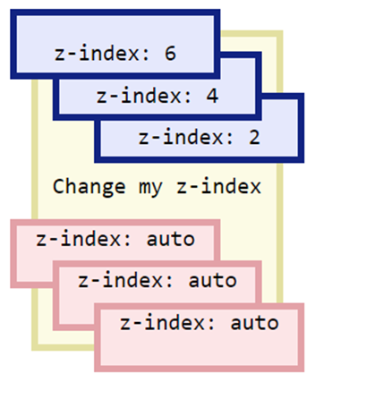
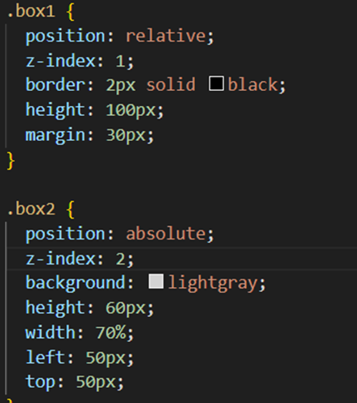
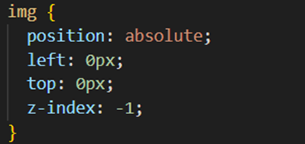
Z-Index
Its Specifies Stack order of an element
It has positive or negative element

Slide 5
Overflow
•Its controls what happens to content that is too big to fit into an area
Its has 3 properties
1.visible
2.hidden
3.scroll
4.auto
Note: overflow property only for block element

Slide 6
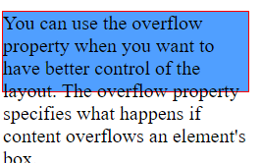
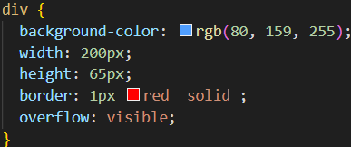
Overflow - Visible
Its default
Its render out site of the element

Slide 7
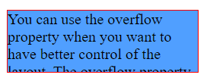
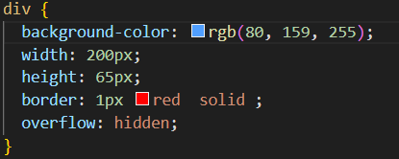
Overflow – hidden
•Rest of the content will be hidden

Slide 8
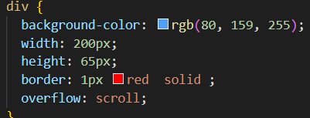
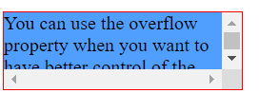
Overflow - Scroll
•Add a scrollbar inside the box
•Adds horizontally and vertically

Slide 9
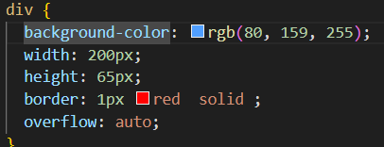
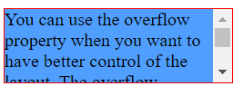
Overflow – Auto
•Its add scrollbar only its necessary

Slide 10
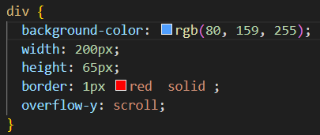
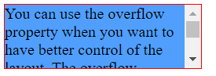
Overflow – x and overflow – y
•Its specifies whether to change the overflow of content horizontally or vertically or both.

Slide 11
Float
•Its specifies how an element should float
•Float can have flowing values
•Left
•Right
•None
•Inherit

Slide 12
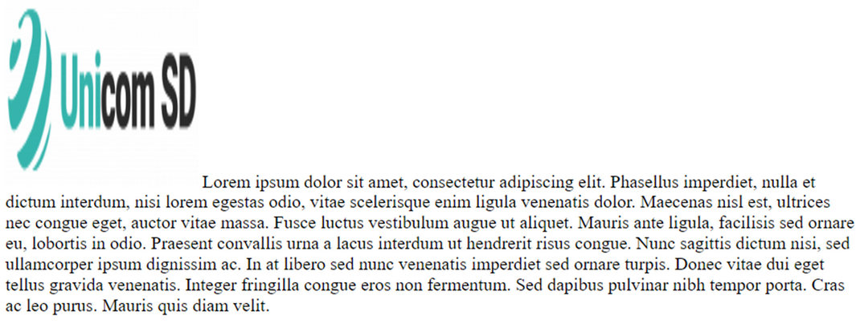
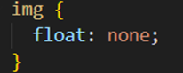
Float – none

Slide 13

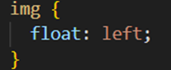
Float –left
•Its specifies the element should float left

Slide 14
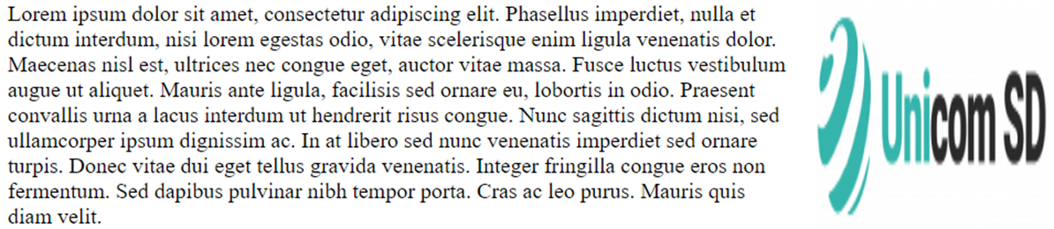
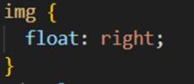
Float -right
•Its specifies the element should float right

Slide 15
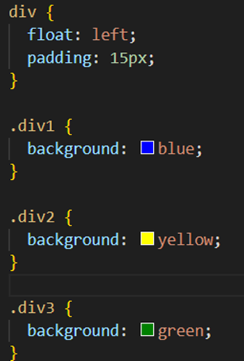
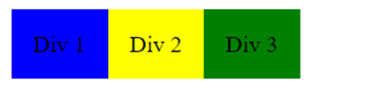
Float Next To Each Others

Slide 16
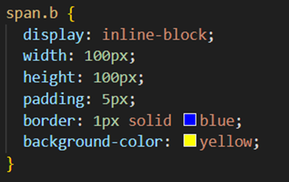
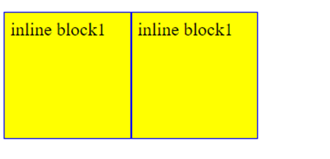
Display: Inline-block
Comparison
•Display inline- cant set height,width ,padding, margin
•Display block – its add line break

Slide 17
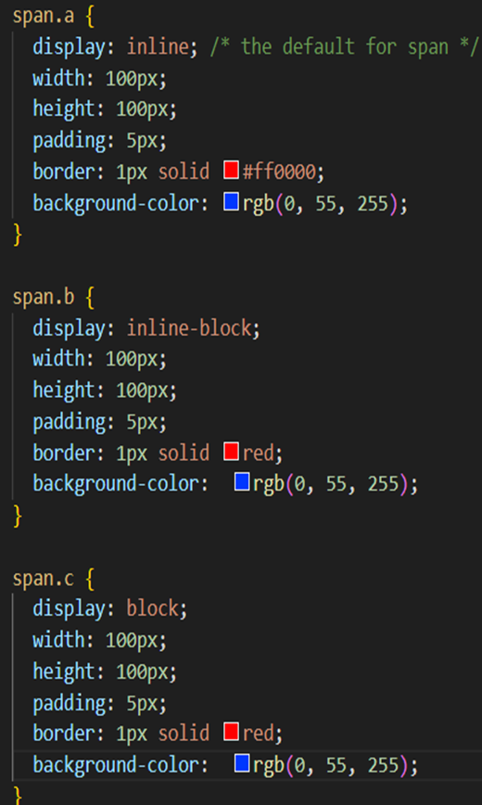
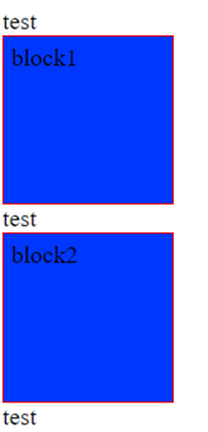
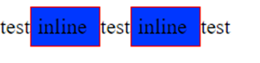
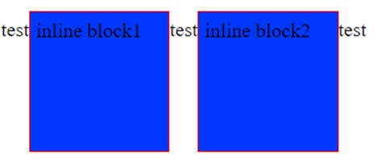
Comparison

Slide 18
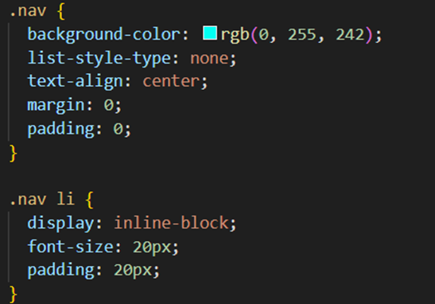
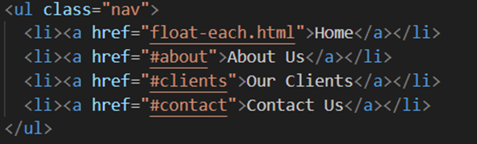
Create navigation bar

Slide 19

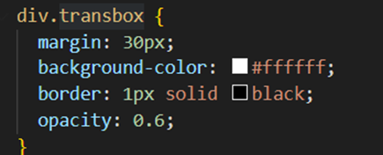
Opacity
•Its specifies transparency of an element
•Value can have 0.0 to 1.0

Slide 20
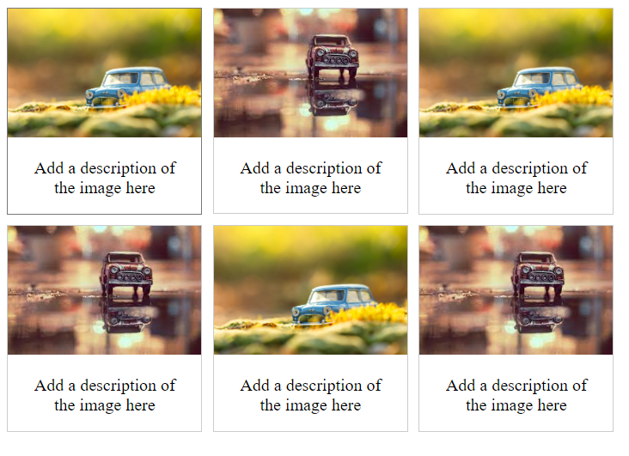
Image gallery

Slide 21
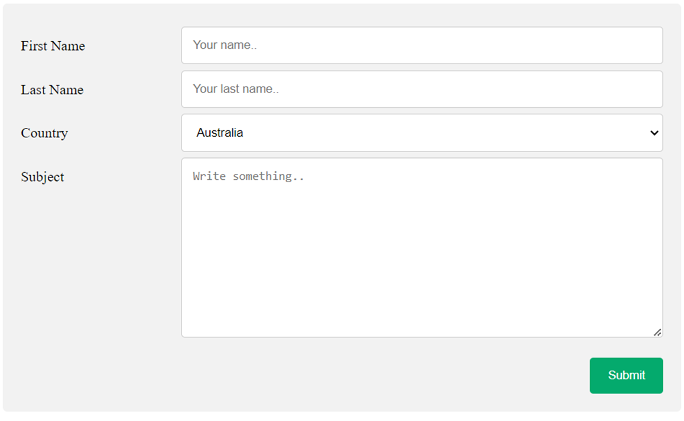
CSS Form

Slide 22


Slide 23
Thanks

